Slide 1
Microsoft Azure
An automated build pipeline with Azure

Slide 2

Azure Web Apps is a fast and simple way to create web apps using ASP.NET, Java, Node.js or PHP. Deliver value faster to your customers with a continuous integration and continuous deployment (CI/CD) pipeline which pushes each of your changes automatically to Web Apps.
Visual Studio Team Services (VSTS) and Team Foundation Server (TFS) provide a highly configurable and manageable pipeline for releases to multiple environments such as development, staging, QA, and production environments; including requiring approvals at specific stages.
Created one sample ASP.NET MVC based web application which will be hosted in Azure web apps.
For continuous integration and deployment I have configured build and release pipeline in VSTS. On each check-in to TFS, build pipeline will automatically get trigger and create a package for deployment. After successfully building code, new release will be created in release pipeline. Code will be automatically deployed to all environments based on release pipeline set up. This solutions helps in automatically managing builds, deployments and verification of code which will save an ample amount of time and cost. Azure web apps also integrated with Azure SQL Server for data source. I have created azure resource plan, web apps, SQL database, SQL server and application insights for all three environments (development, QA, production).
Brief Synopsis

Slide 3
Automatic continues integration and deployment of code using VSTS and TFS.
Using Azure web apps for faster and easy web application hosting.
It takes lot of time to manually build code and deploy to various environments, this solution will help in reducing this cycle time and cost.
Low maintenance cost since it is automatic build and release pipeline.
It is easy to integrate new environment by using azure automatic template to create new resources on azure.
Application insights will help in troubleshooting any issue and generating alerts if there is any issue in application or web server.
VSTS release pipeline also provides feature to get approval before any deployment to specific environment.
Using Azure app service plan helps in keeping low infrastructure cost by upgrading or degrading it based on traffic.
Easy to add/edit or remove tasks in release pipeline.
These services run in a high-availability environment, patched and supported, allowing you to focus on your solution instead of the environment they run in.
Easy to import and export release pipelines on VSTS.
Problem being solved

Slide 4
ASP.NET MVC 5 web application
VSTS/TFS
Azure Resource group
Azure Service plan
Azure Web apps
Azure Application Insights
Visual Studio 2013
Azure SQL Server
Azure SQL Database
Microsoft management Studio 2014
Entity Framework
Azure Availability test
Azure Storage Account
Microsoft release management
Technology/Tool/Azure Stack

Slide 5
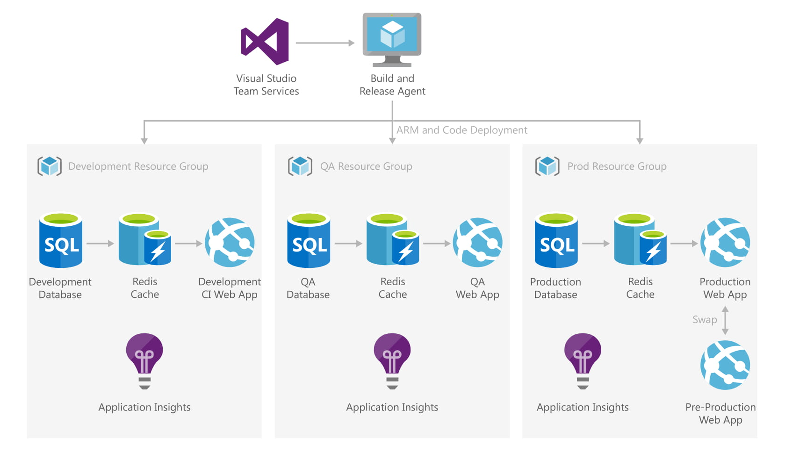
Solution architecture
Using VSTS, created build and release pipeline to build and deploy code to various environments. Build and Release agent will build code once user check-in to TFS. After build web application will be deployed to various environments on azure web app. SQL server is used as data source and Redis cache will be provide high resilience and performance to overall system. Application insights is used for monitoring and troubleshooting. CI/CD pipeline is shown in next slide for specific environment

Slide 6
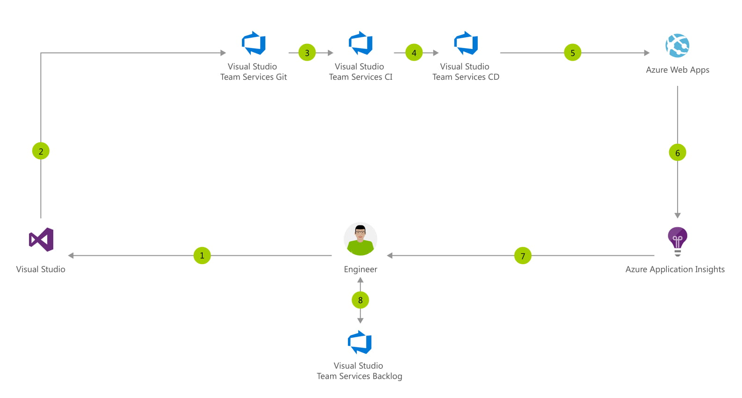
Solution architecture

Slide 7
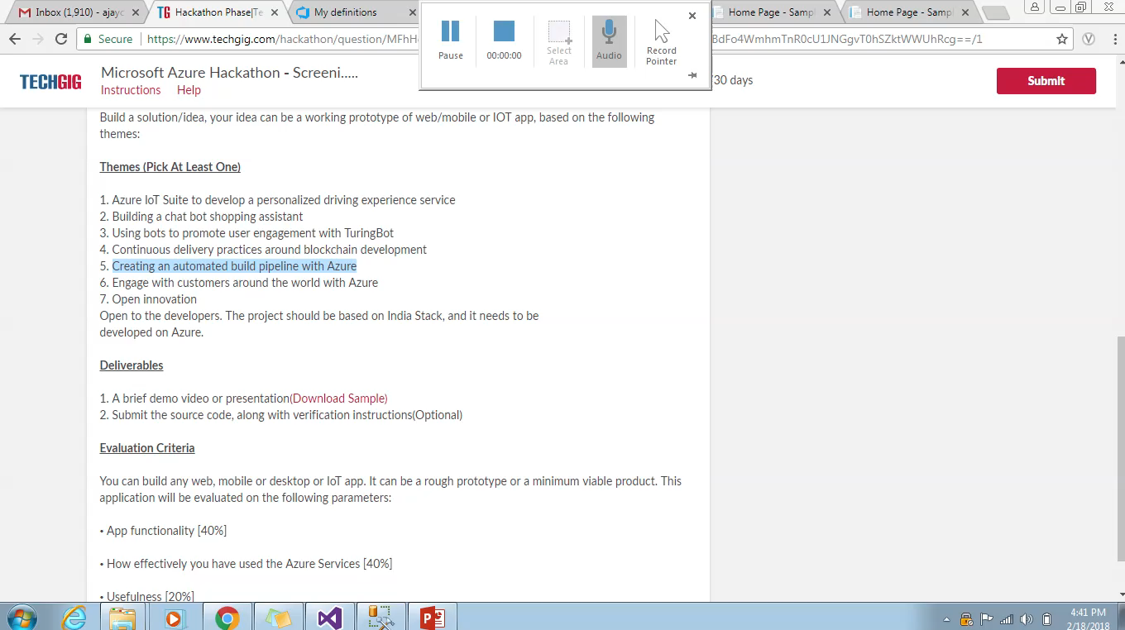
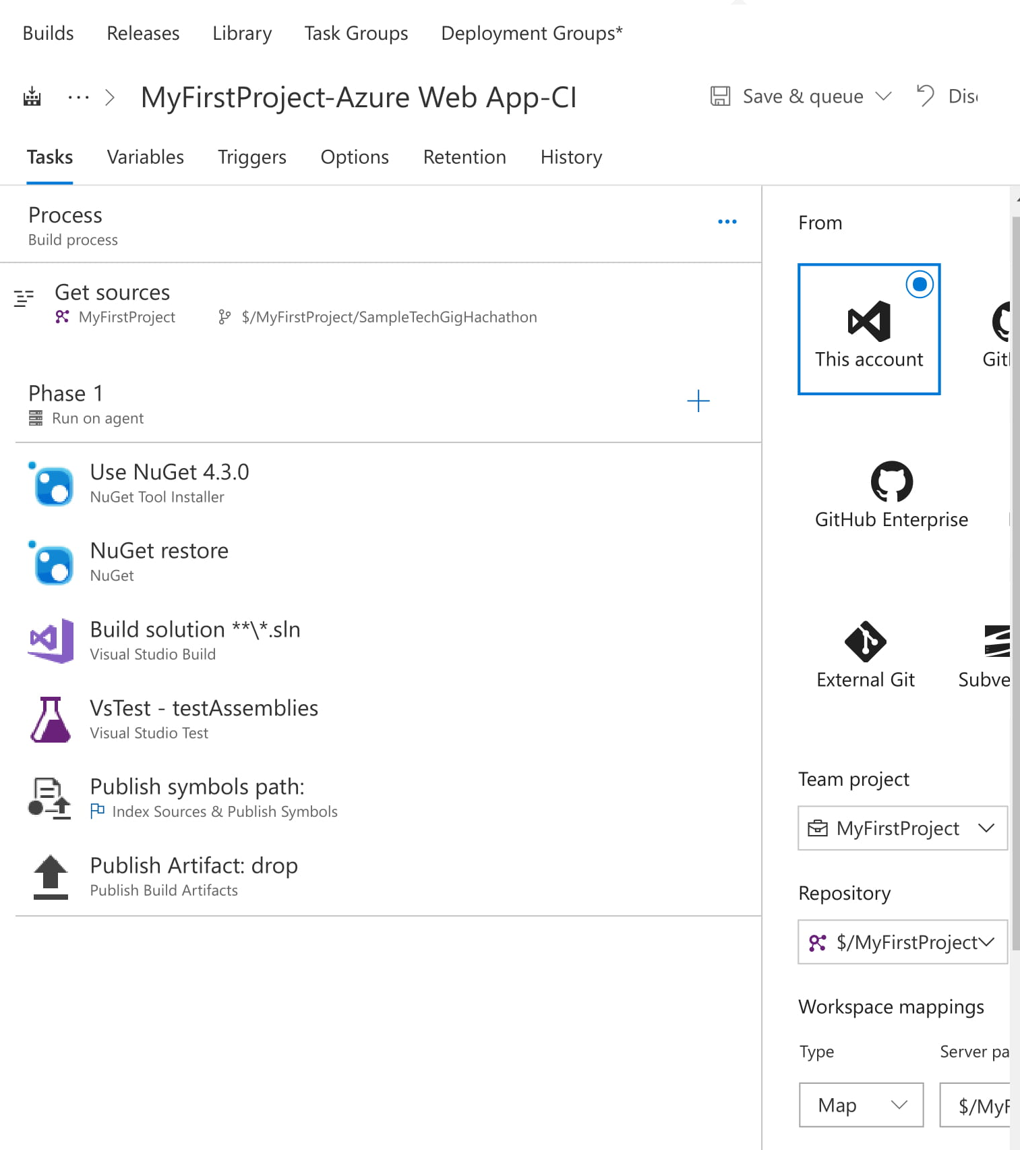
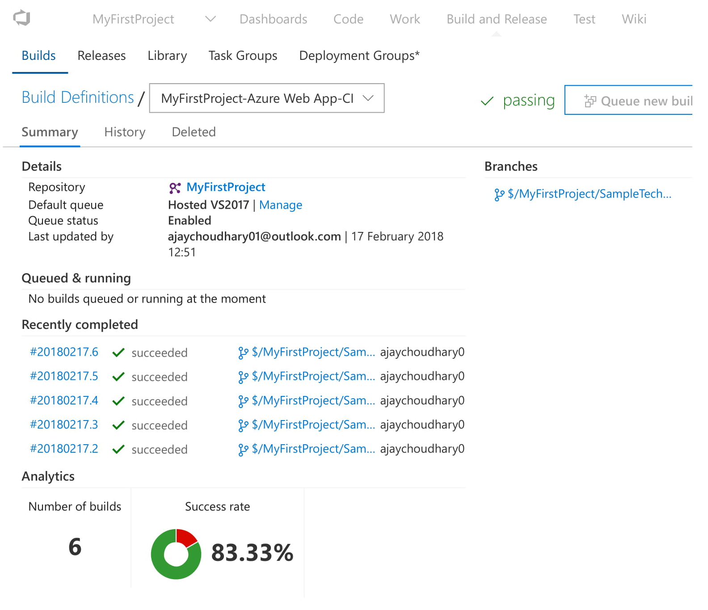
Prototype/Screenshots-release setup

Slide 8
Faced some issues related to web apps and Azure SQL Server connectivity which was later resolved by changing SQL server firewall settings.
Some of the SQL Server resource types can not exported into automatic script template, this is azure issue which needs fix from their side, added those resource manually to fix it for now.
Challenges faced

Slide 9
Possible Improvement
01
Automatic Testing
Automatic development testing using unit tests and QA testing using integrations tests can be integrated. Performance testing/environment can also be set up for performance verification.
02
Automatic Azure stack
A Jenkins or GOCD pipeline can be set up to automatically create azure stacks

Slide 10


